Slide 1
Soft Electricals
Lashya.B
Lahari.G
Ganesh.D
Naveen Kumar
Rao.M

Slide 2
MNIST Classification using CNN

Slide 3
Lists [ ]
01
Introduction
02
Objective
03
Key Role
04
Applications
05
Conclusion

Slide 4
Introduction
ANN
CNN

Slide 5
Objective

Slide 6
Key Role
What is a MNIST…???
Why do we use it…???

Slide 7
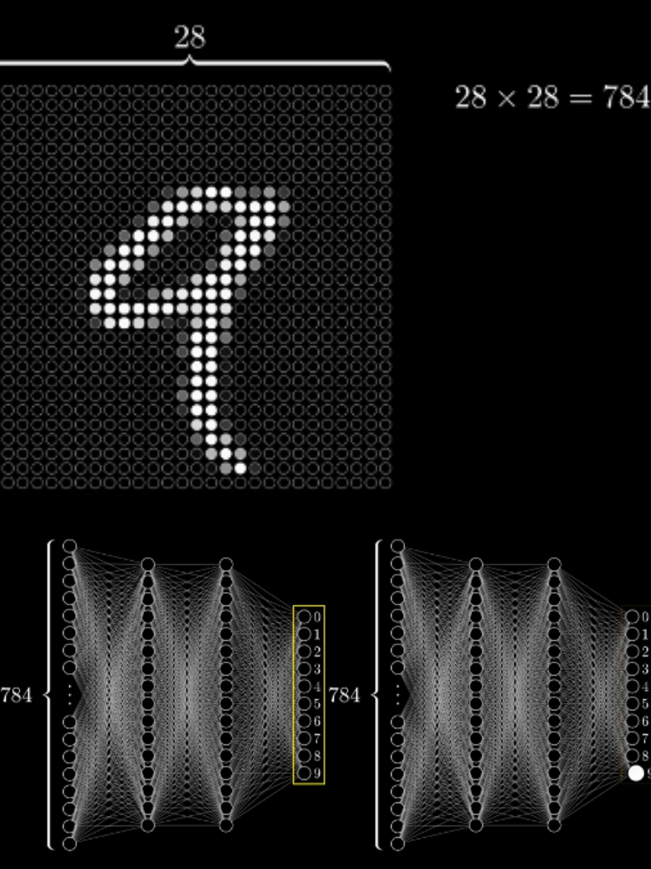
Analysis

Slide 8
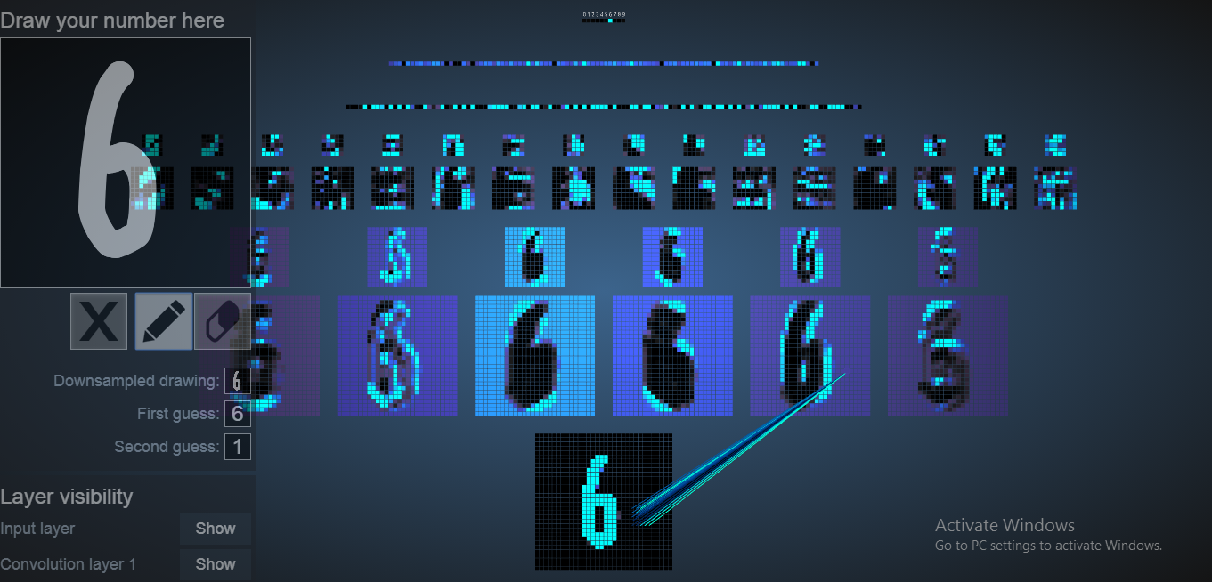

Slide 9
Applications
Kindle services
Electric slates

Slide 10

Conclusion

Slide 11


